Slide 1
Introduction to
Illumina sequencing and mNGS data analysis
Rapid Response – Updated January 2026

Slide 2







mNGS pipeline
Study design
xNA extraction
Library prep
Sequencing
Data analysis
Pathogen ID
Type(s)
Controls
Storage
Lab setup
Type(s)
Controls
QC
Host removal
Fragmentation
dsDNA generation
End-repair
Adapter ligation
Barcoding & PCR
Clean-up
Pooling
QC
Machine
Read length
Loading conc.
QC data
Host removal
Alignment
Blast
Ranking of hits
INTRODUCTION

Slide 3
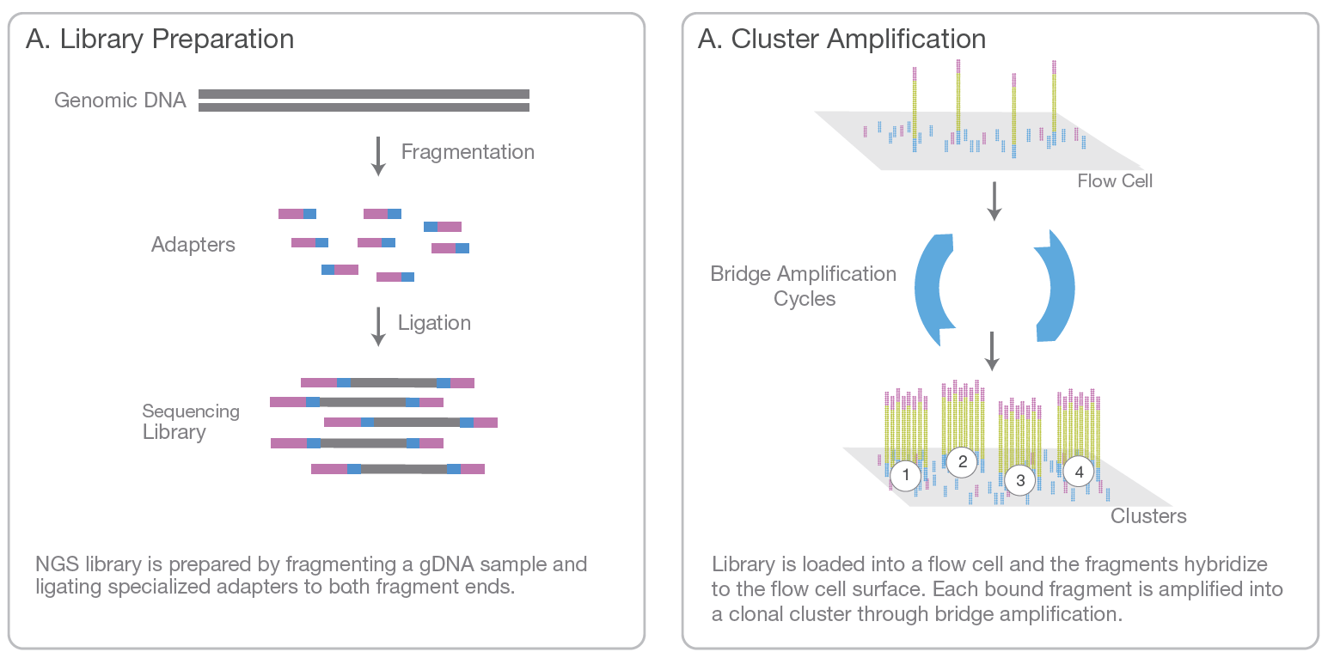

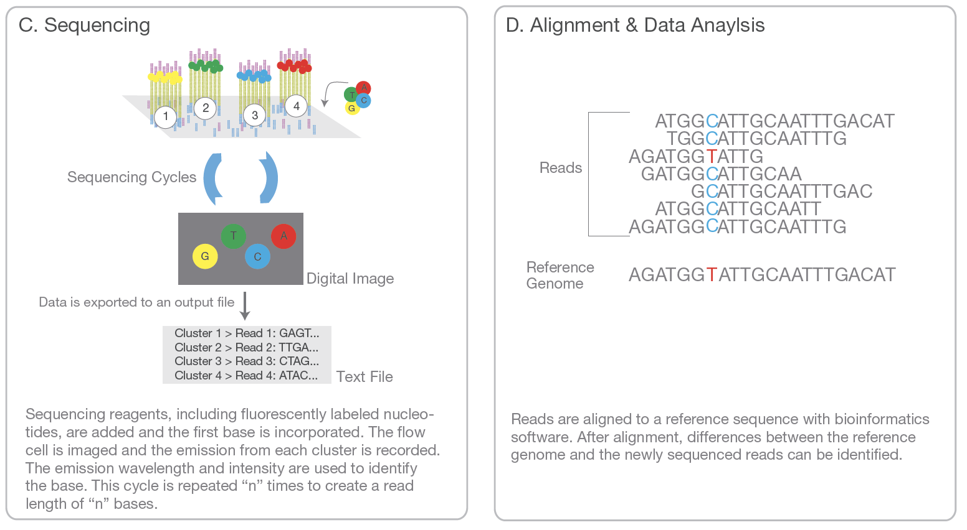
B. Cluster Amplification
Introduction to illumina Next-Generation sequencing (NGS)
Notes:
From: Illumina_sequencing_introduction.pdf

Slide 4
Next-generation sequencing (NGS)
What is a library?
What is a read?
What is paired-end sequencing?
What is a cluster?
What is (de-)multiplexing?
What is a fastq file?
What is coverage?

Slide 5
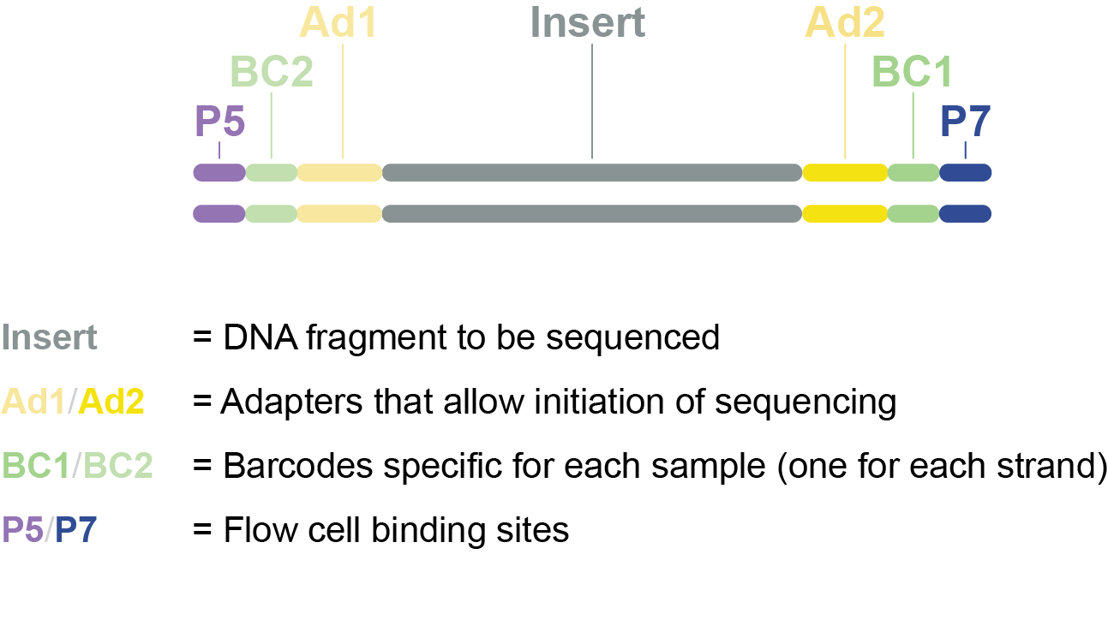
Sequencing library = collection of fragments ready for sequencing
DNA is fragmented into smaller pieces, optimal for sequencing
Adapter sequences, barcode sequences and flow cell binding sites are added to allow the sequencing process to occur
Sample library

Slide 6
Cluster formation through bridge amplification
B. Cluster Amplification
Notes:
From: Illumina_sequencing_introduction.pdf

Slide 7
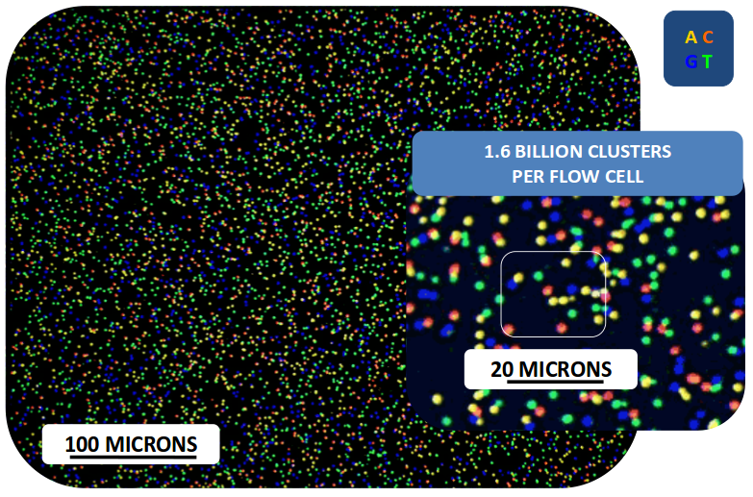
Fluorescence imaging
Notes:
From: Illumina_sequencing_introduction.pdf

Slide 8
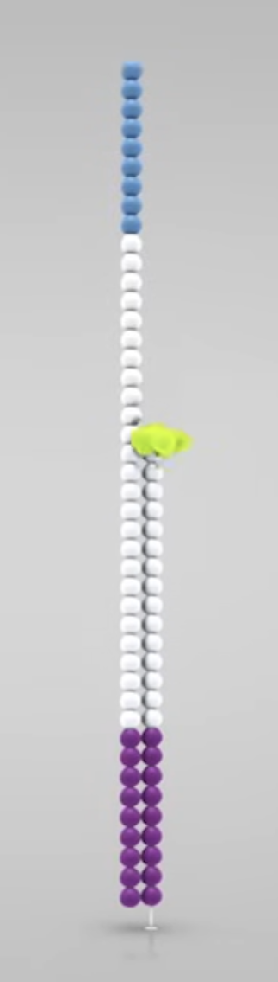
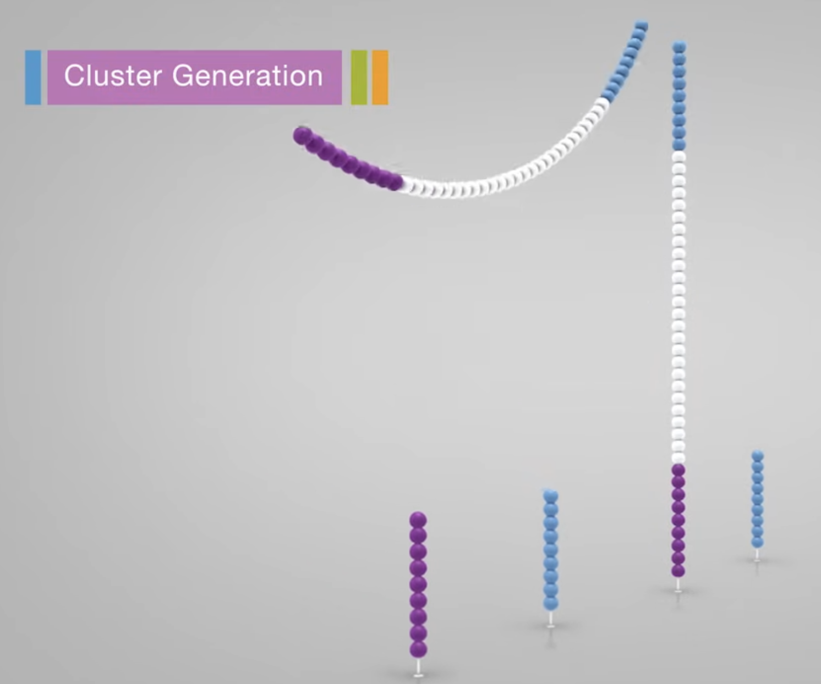
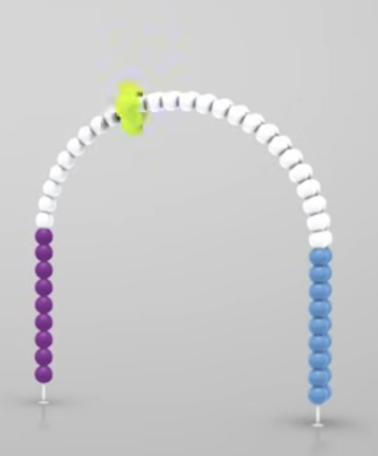

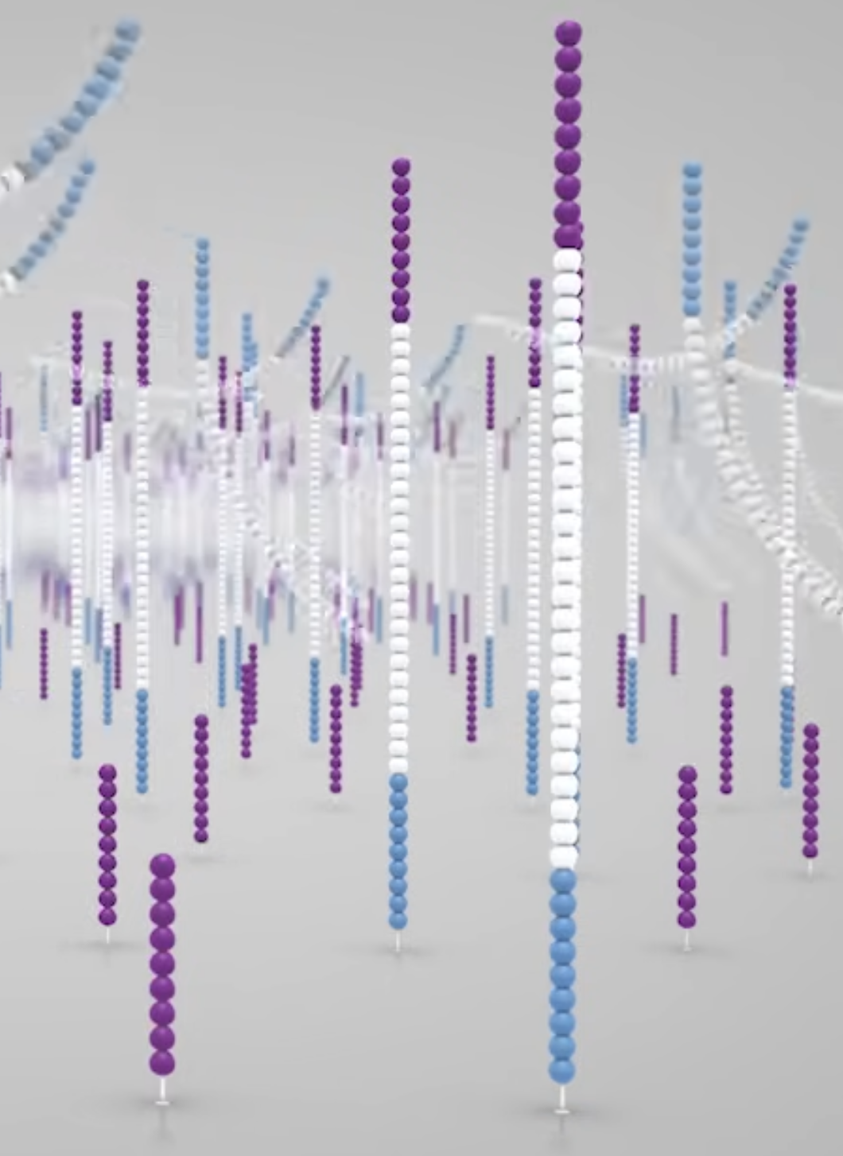
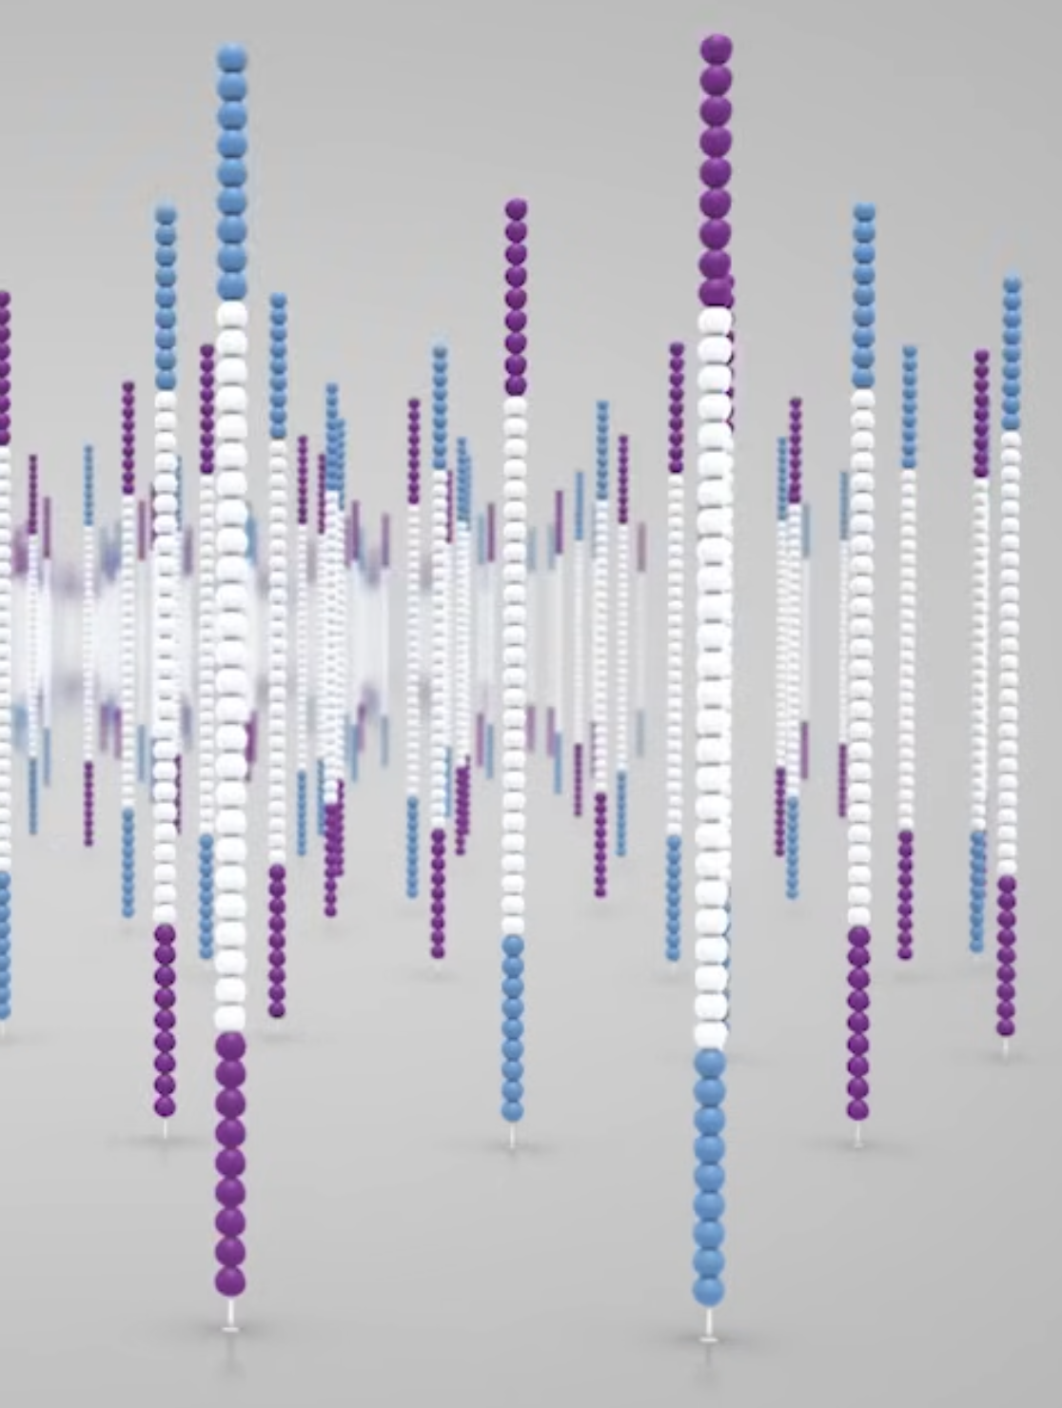
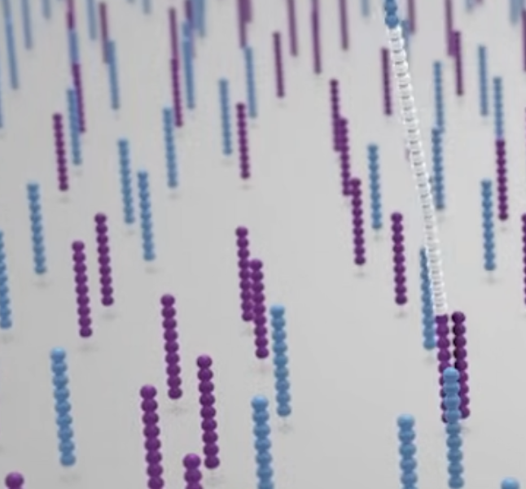
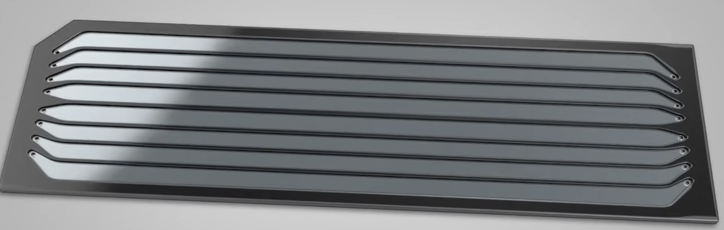
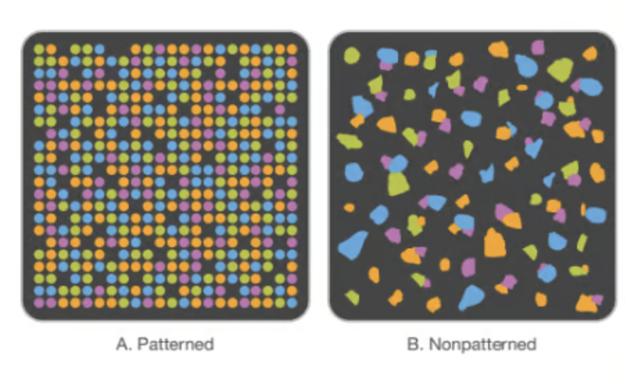
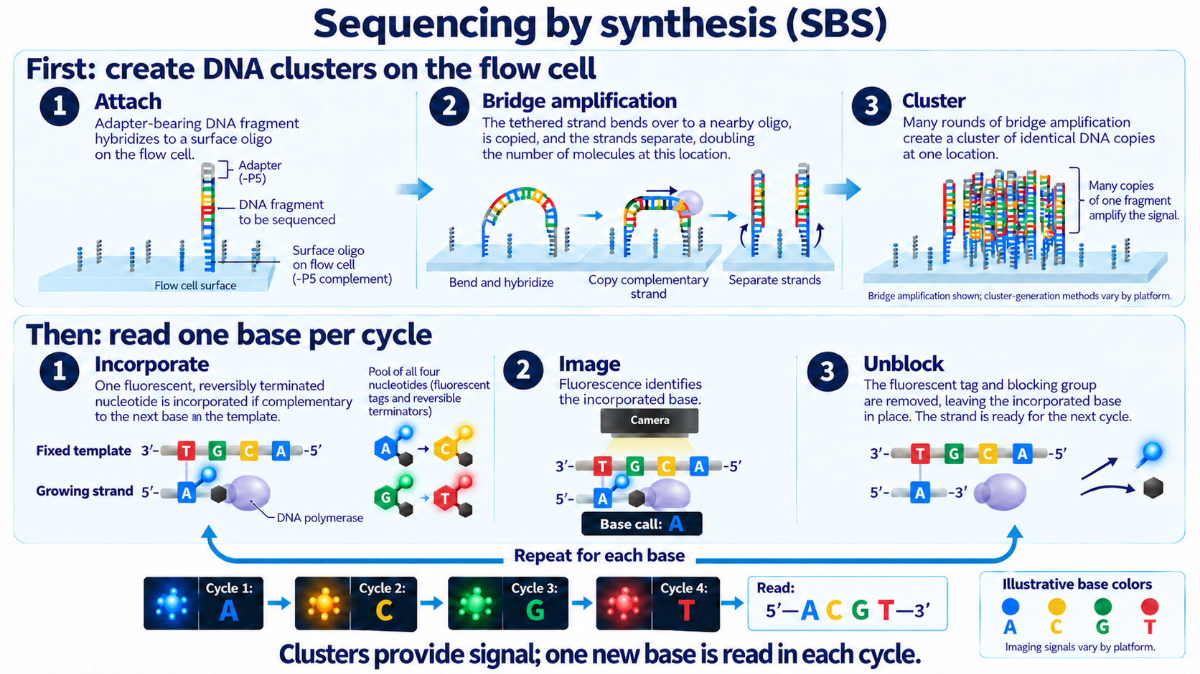
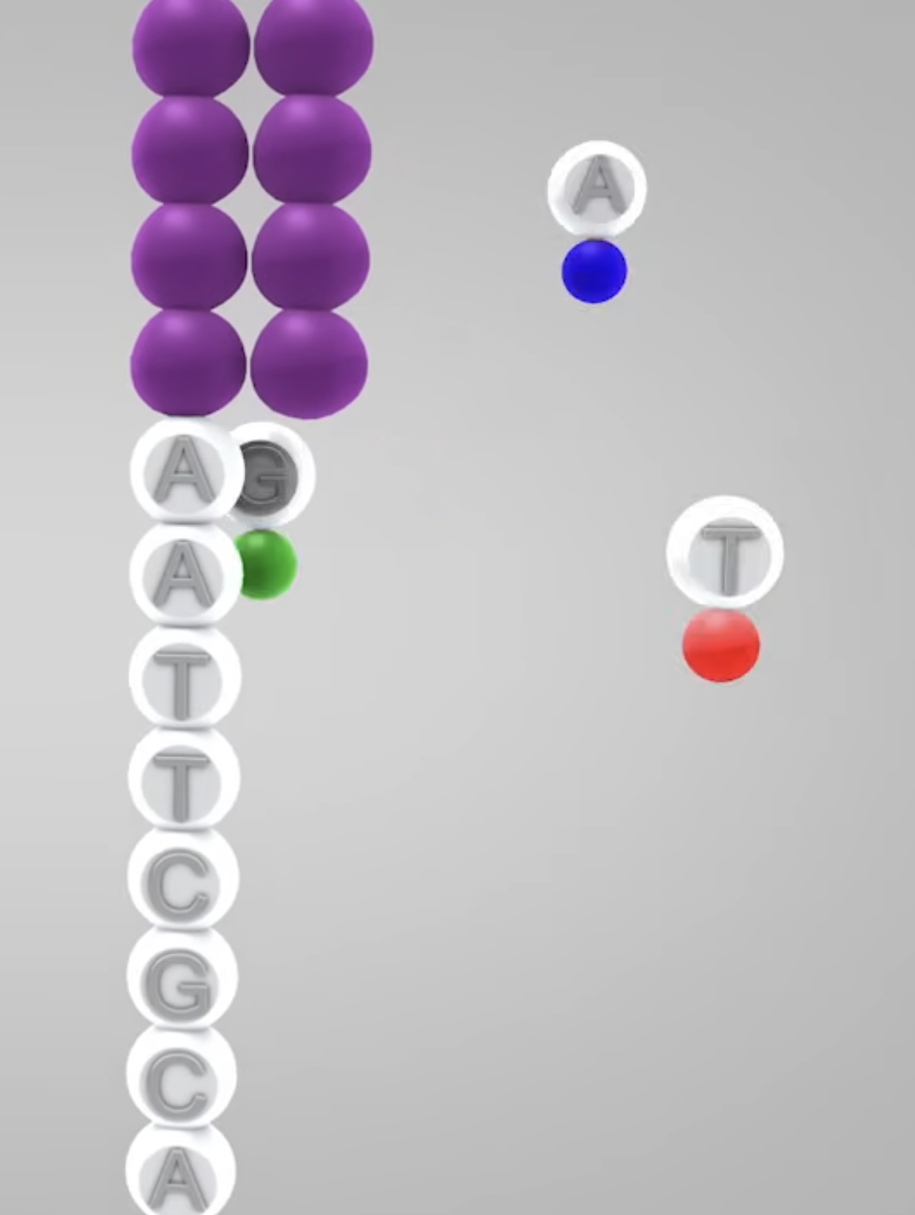




Sequencing By Synthesis (SBS)
1.Cluster formation through bridge amplification: the result is a lawn of clonal ssDNA ‘islands’
2.Nucleotides emit in each incorporation cycle
3.Sequencing is done by imaging fluorescence at each cycle
Notes:
From: Illumina_sequencing_introduction.pdf

Slide 9
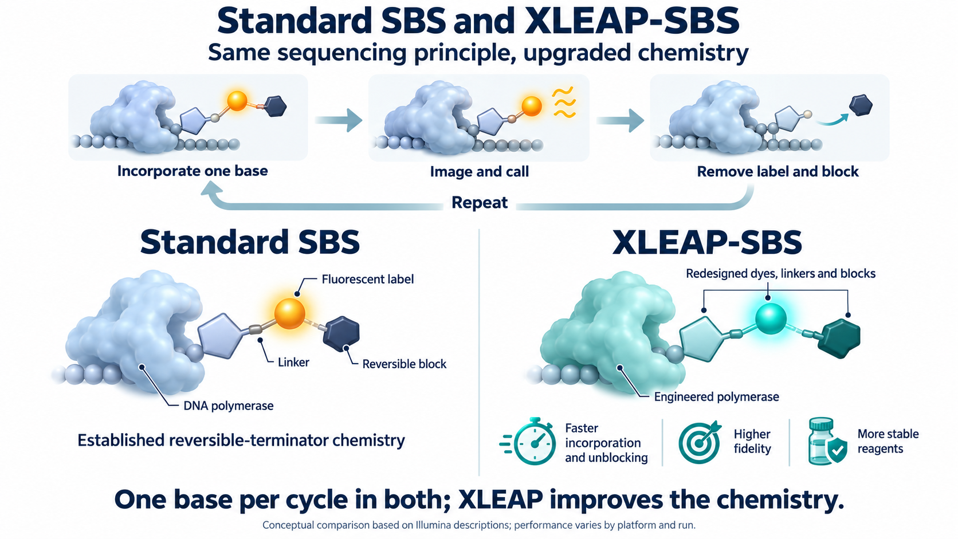
XLEAP-SBS Chemistry update
Notes:
From: Illumina_sequencing_introduction.pdf

Slide 10
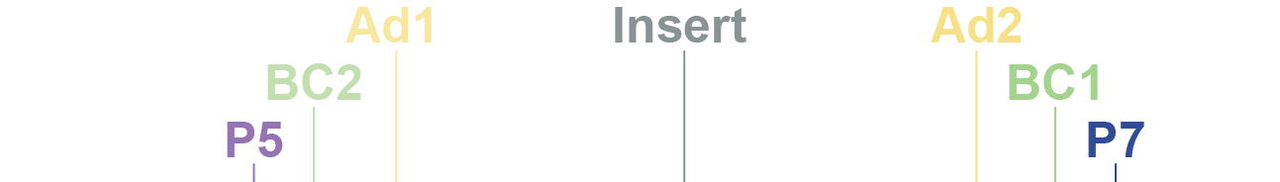
Sequencing read order
F
L
O
W
C
E
L
L
F
L
O
W
C
E
L
L
Read 1
Read 2

Slide 11
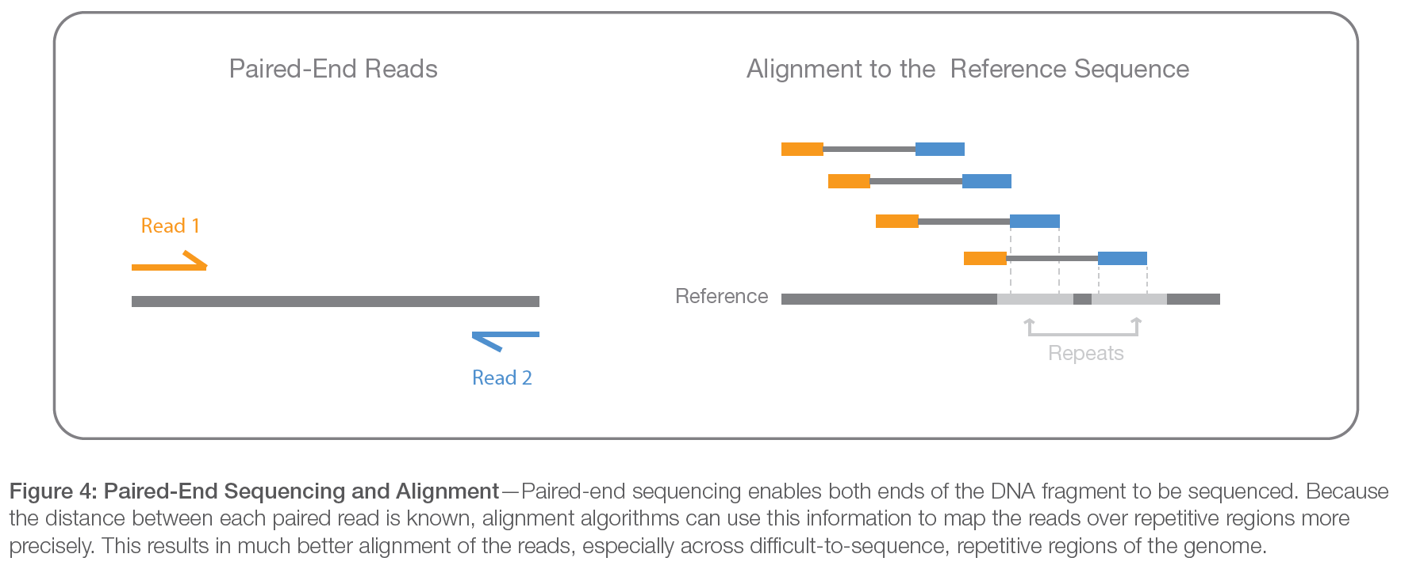
Paired-End sequencing
Paired-end sequencing
Notes:
From: Illumina_sequencing_introduction.pdf

Slide 12
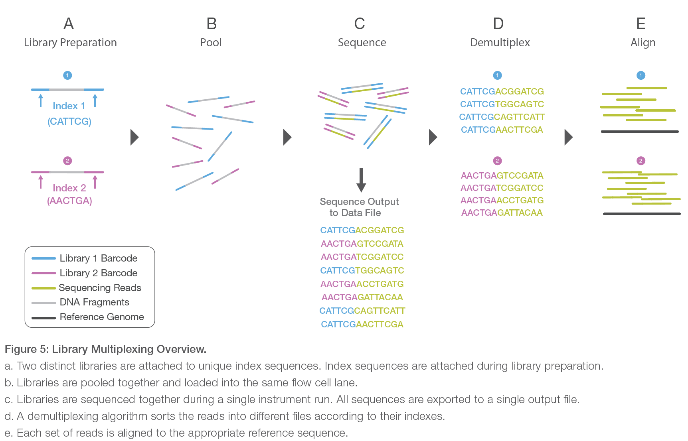
Pooling and demultiplexing
Multiplexing or Pooling = Sequencing multiple samples together in one reaction
Notes:
From: Illumina_sequencing_introduction.pdf

Slide 13
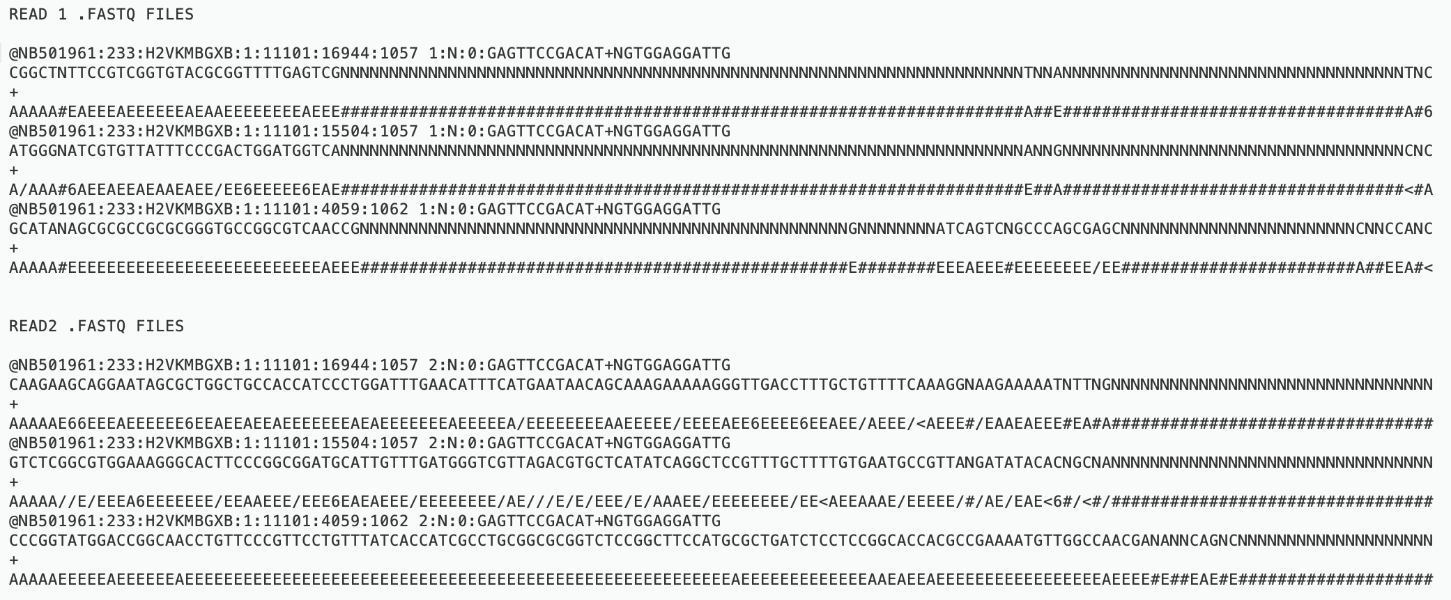
fastq file = raw data file containing sequencing data, generated by sequencer
Sequencer will demultiplex sequencing data, resulting in a two fastq files per sample (read 1 and read 2)

Slide 14
fastq file = raw data file containing sequencing data, generated by sequencer
Example Read1.fastq
@NB501961:14:HM7TLBGX2:1:11102:3233:17234 1:N:0:GATCACCA+GATCACCA
CATTCGGCTGGGTTTCGTCACCCTGCGGGAAGATGCGGGTCCAGGCGATAGAGGTGCGGAAGCATTTGAAGCCCA
+
AAAAAEEEEEEEEEE/EEEEEEEEEEEEEEEEEEEEEE<EEEEEEEEE//EAEEEEEEAA/EEE/EEAAEEE<6/
Each read is described by 4 elements in 4 lines:
A sequence identifier with information about the run (always starts with ‘@’)
The base calls: A, C, T, G and N
A separator, which is simply a plus (+) sign
The base call quality scores (coded in ascii format)
Quality Score | Probability of Incorrect Base Call | Inferred Base Call Accuracy
10 (Q10) | 1 in 10 | 90%
20 (Q20) | 1 in 100 | 99%
30 (Q30) | 1 in 1000 | 99.90%
@<instrument>:<run number>:<flowcell ID>: <lane>:<tile>:<x-pos>:<y-pos> <read>:<is filtered>:<control number>:<sample number>
Q = -10log₁₀(e)
Notes:
@<instrument>:<run number>:<flowcell ID>:<lane>:<tile>:<x-pos>:<y-pos> <read>:<is filtered>:<control number>:<sample number>

Slide 15
Coverage = How many times a base has been sequenced
Coverage = How many times each base has been sequenced on average throughout the genome
Coverage depth = 16
Coverage depth = 10
Reads aligned to reference genome
Coverage depth = 4
Reference genome
Notes:
A higher coverage results in a higher quality (fewer ‘false’ mutations).

Slide 16
Next: 07-I_ iSeq 100 / MiSeq loading and sequencing

